Slide 1
MP3 format
April-2022, Logash

Slide 2
MP3
– Moving Picture Experts Group

Slide 3
MP3 format
Lossy formats
Uncompressed formats
Lossless formats
MP3
AAC
WAV
AIF
DSD
PSM
FLAC
ALAC

Slide 4
How files are compressed?

Slide 5




MP3
(lossy)
(original)
WAV
(uncompressed)
FLAC
(lossless)

Slide 6
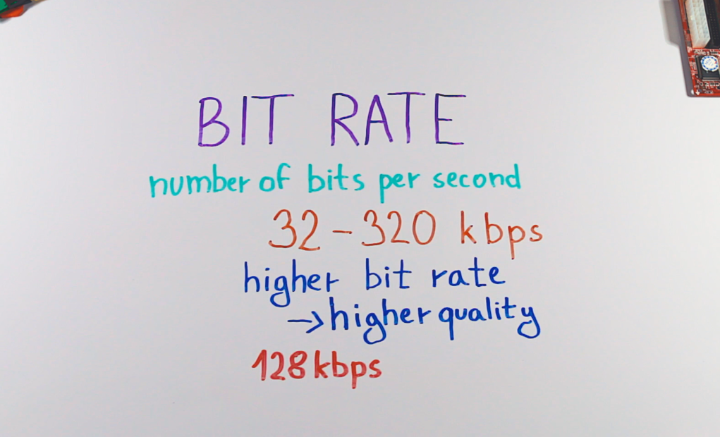

Slide 7
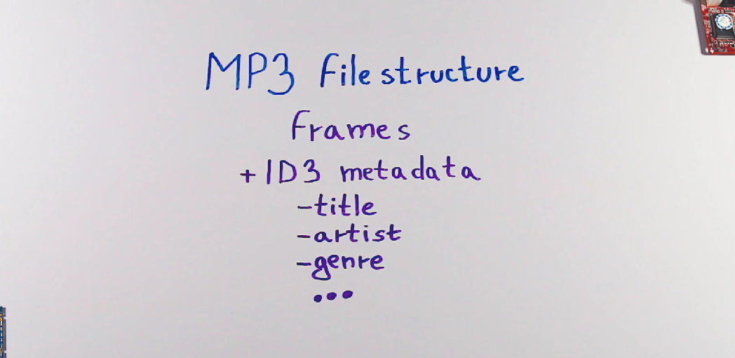

Slide 8
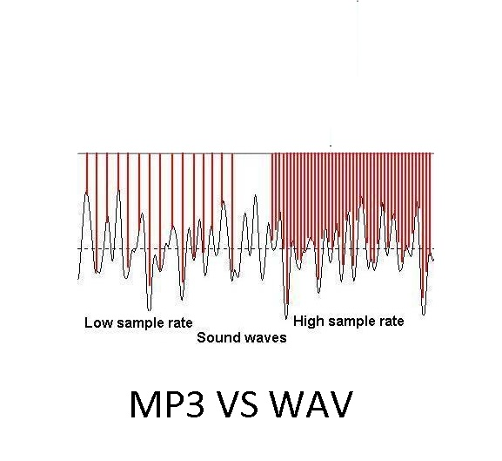

Slide 9
